Slide 1
NativeScript + Angular 2
Jen Looper
Developer Advocate
@jenlooper

Slide 2

What is NativeScript?
Open source framework
Create native mobile apps for iOS, Android (and eventually Windows Universal)
Use JavaScript (“web skills”)
Write once, run everywhere
Share 100% code between iOS/Android
Share 80% code with web
Reuse popular plugins from NodeJS/iOS/Android
Integrates deeply with Angular and TypeScript

Slide 3
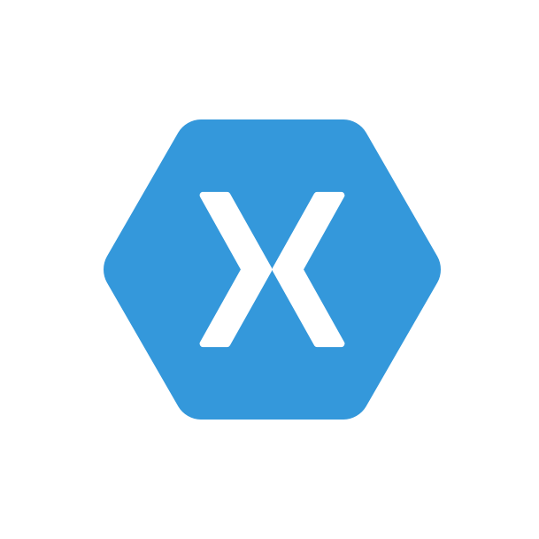




“Cross-compile”
“Native Hybrid”
“Web Hybrid”
+
Xamarin
(owned by Microsoft)
React Native
(owned by Facebook)
Fuse Tools
Ionic
(+ PhoneGap)

Slide 4
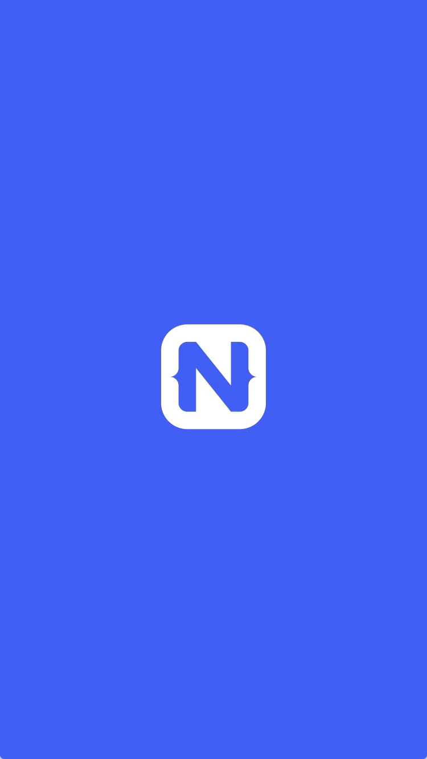
Rich, animated, “no compromise” native UI
Cross platform)

Slide 5
Two ways to write NativeScript
1)
Standard JS + CSS + XML
2)
Angular 2

Slide 6

Notes:
For the past several months we’ve been working directly with the Angular team to bring Angular 2 and NativeScript together…
We are doing this to provide the same experience of building mobile apps as it is for web apps.
And thus allowing Angular 2 developers to reuse their skills.
It’s all about skills reuse and code reuse.

Slide 7


Slide 8
Notes:
We announced our collaboration with Google at our 2015 Telerik Next conference

Slide 9

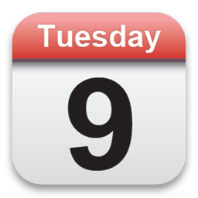

Tobias Bosch
Hristo Deshev
Notes:
So, regularly since May 9 also in 2015, :
A lead developer from the Angular Team [picture of Tobias Bosch]
and Telerik Team [picture of Hristo Deshev]
met using Google Hangouts to plan how NativeScript‘s integration with Angular 2

Slide 10

ngConf
Fast facts:
May 4th to 6th in Salt Lake City
Largest Angular developer event in US (~1300 developers)
Notes:
Fast forward, a year later … At ngConf in May 2016 we laid down the gauntlet and revealed our deep relationship with Google as well as a flagship app built by our partners at Rangle.io who built the Kiva app in NNG

Slide 11
Why NativeScript + Angular 2?
Angular 1 = a technology that relies on browser tech to manipulate the DOM.
NativeScript has no DOM to manipulate
Angular 2 decoupled the Angular framework from the DOM
The door is open to new mobile-friendly tech to leverage this newly decoupled framework!!
Notes:
N apps can’t use browser tech like span etc. to build an interface, you must build using N ui components

Slide 12
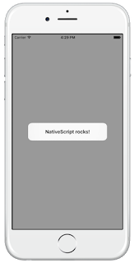
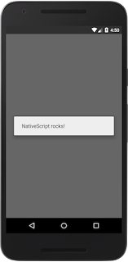
A standard {N} app snippet
<!-- main.xml --> <page>
<StackLayout>
<Button text= "Hello World" tap= "showAlert" />
</StackLayout>
</page> /* main.js */ var dialogs = require("ui/dialogs"); exports.showAlert = function() { dialogs.alert({ message: "NativeScript rocks!" }); };
Notes:
This code will open a native dialog when a native button is tapped

Slide 13
Same functionality, {N} + ng2
// main.ts import {nativeScriptBootstrap} from "nativescript-angular/application"; import {Component, View} from "angular2/angular2"; import {dialogs} from "ui/dialogs"; @Component({}) @View({ directives: [], template: ` <stack-layout> <button (tap)="showAlert()" text="Hello World"></button> </stack-layout> ` }) class HelloPage { showAlert() { dialogs.alert({ message: "NativeScript rocks!" }); } } export function loaded() { nativeScriptBootstrap(HelloPage, []); }
Notes:
NativeScriptBootstrap() vs. bootstrap()
In an Angular 2 web app, you call the bootstrap() function in the "angular2/angular2" module to initialize your components.
In NativeScript apps you need to call nativeScriptBootstrap(), which is a lightweight wrapper of bootstrap() that does some NativeScript-specific initialization.
The UI components in the template
In an Angular 2 web app your “Hello World” button example would probably be rendered as <div><button>Hello World</button></div>.
But in NativeScript apps you need to use XML widgets that NativeScript is able to render in native mobile apps.
This example uses a <stack-layout> element, which is the simplest of NativeScript’s layouts, and places a single <button> element within it.

Slide 14
The big picture
{N} Module
Native
iOS call
Native Android call
iOS App
Android App
Notes:
What’s the incentive to use Angular in your NativeScript app?

Slide 15
The bigger picture ({N}+NG2)
HTTP
<Angular Component>
XMLHttpRequest
<NS Module>
XMLHttpRequest
<Browser>
Native
iOS call
Native Android call
Ajax call
iOS App
Android App
Web App
Notes:
A NativeScript app with Angular love - that's going to have code reuse to the web.
Leverage angular components to wrap up your {N} and Browser modules, and then use NativeScript to build your mobile apps, and browser technologies to build your web apps.
You are able to share about 60-80% of your app code, especially on the server tier, to build for both web and native mobile using a core technology, Angular 2 + NativeScript.

Slide 16
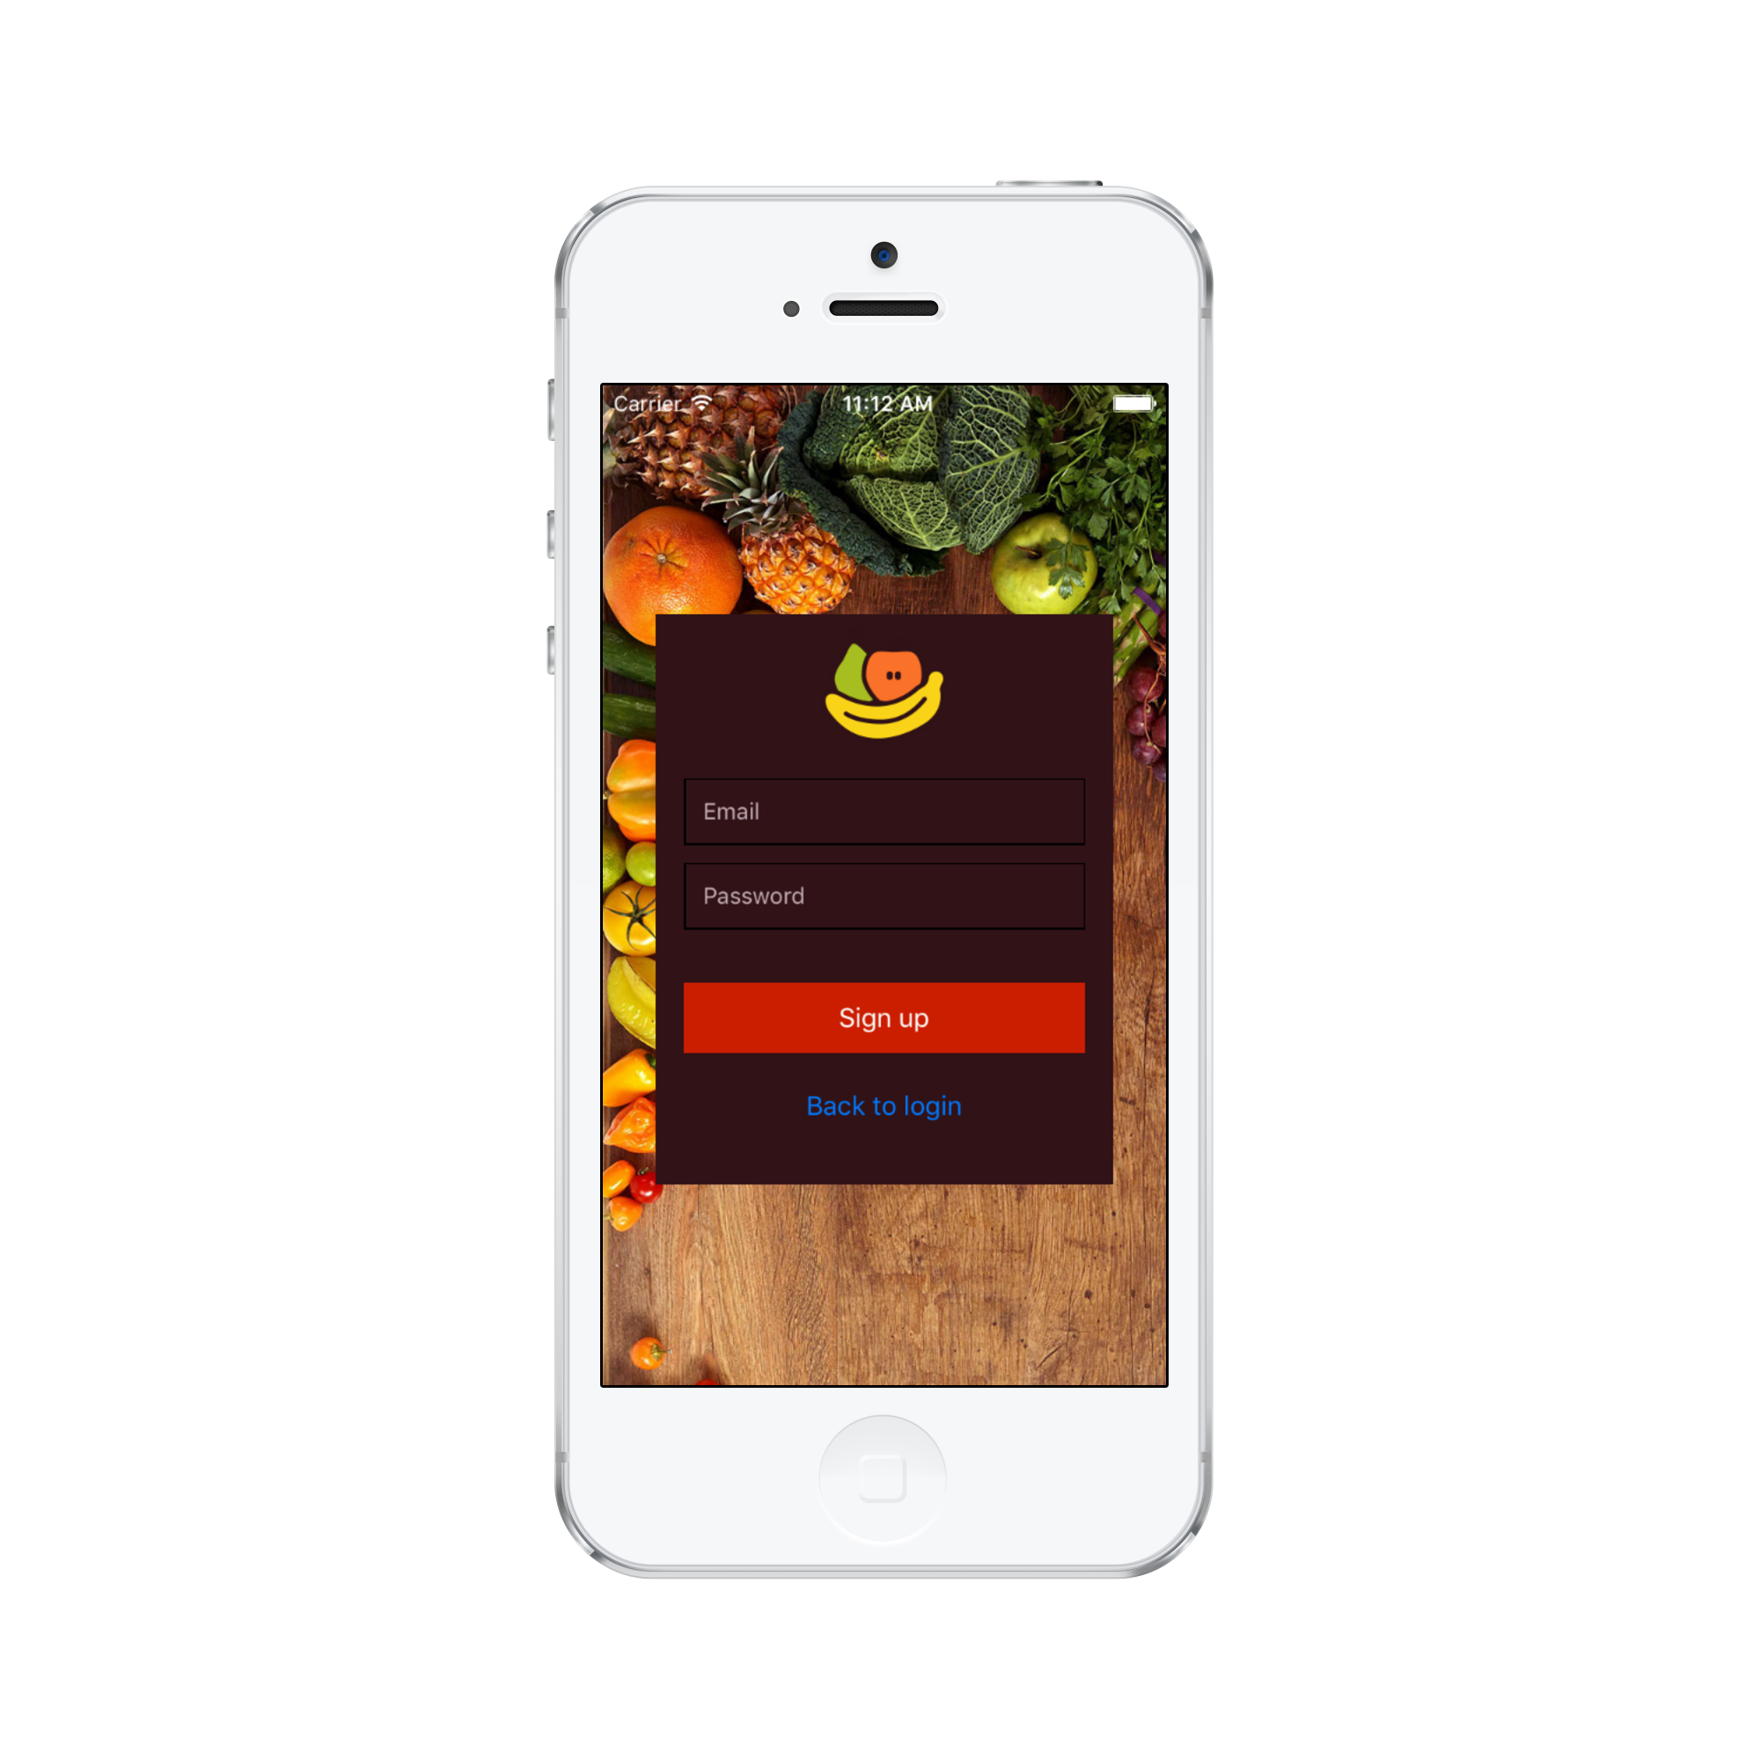
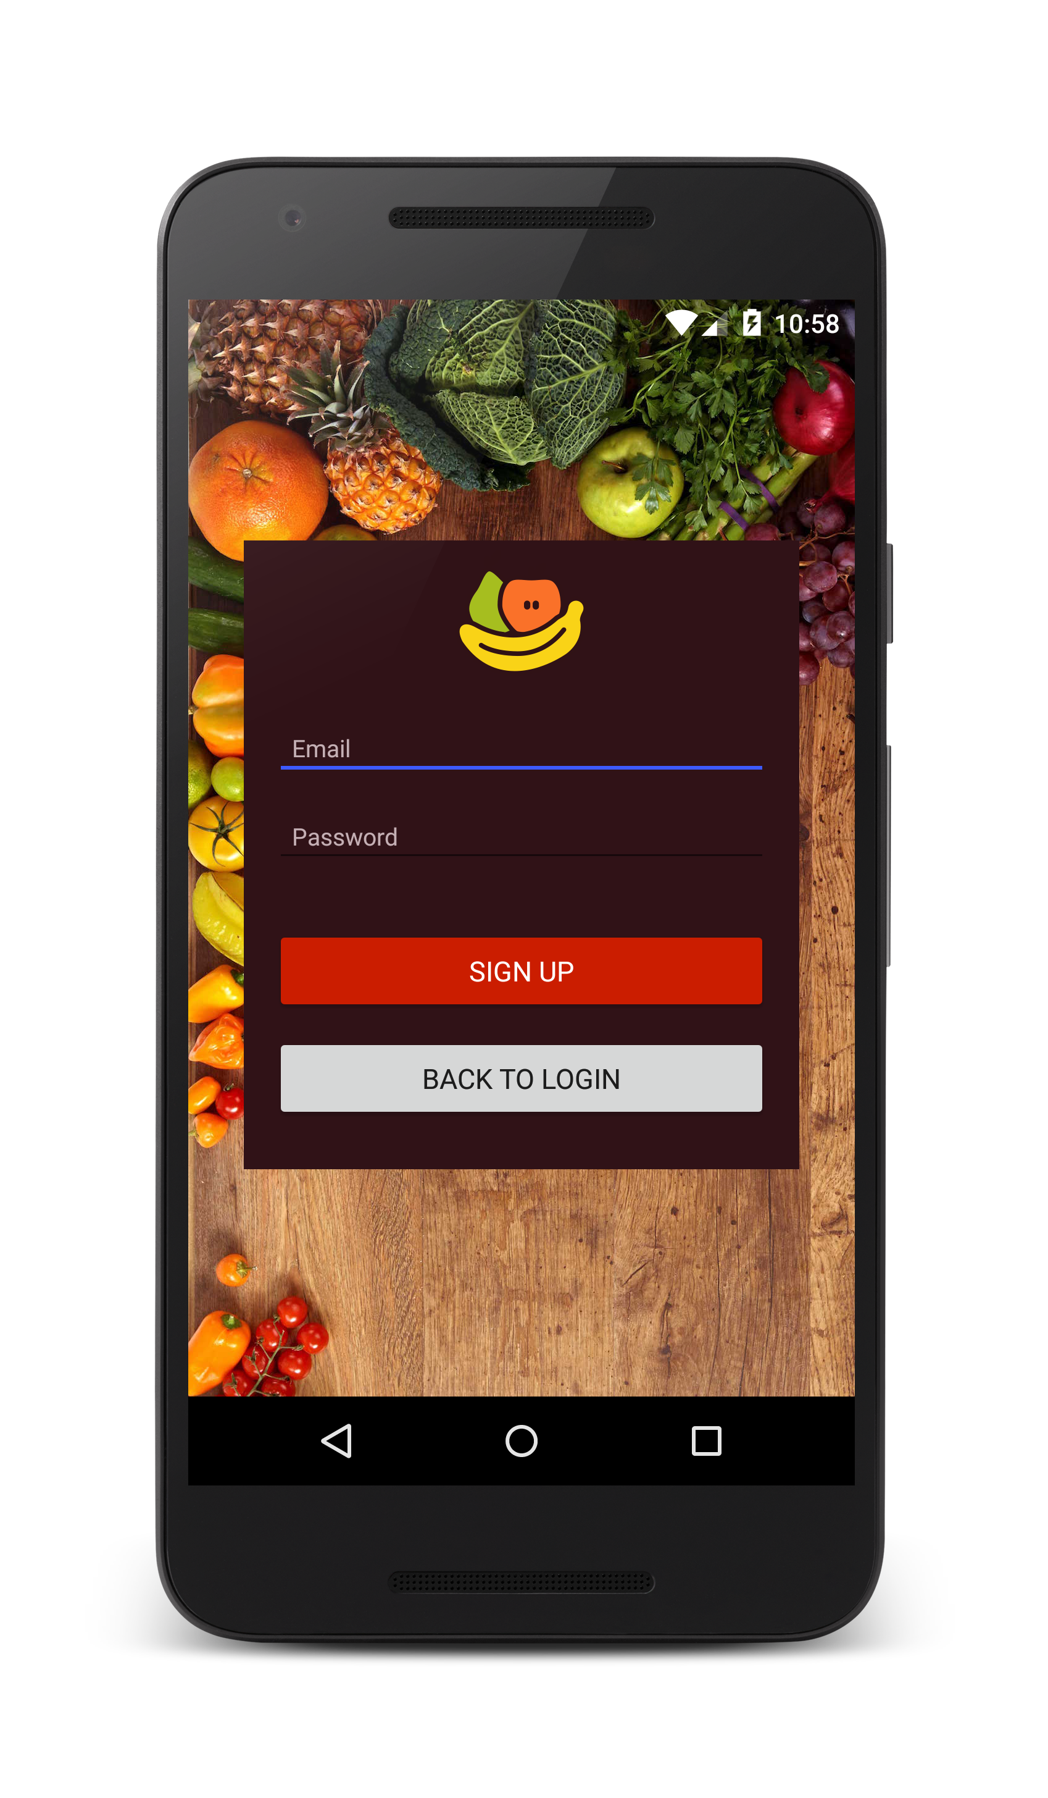

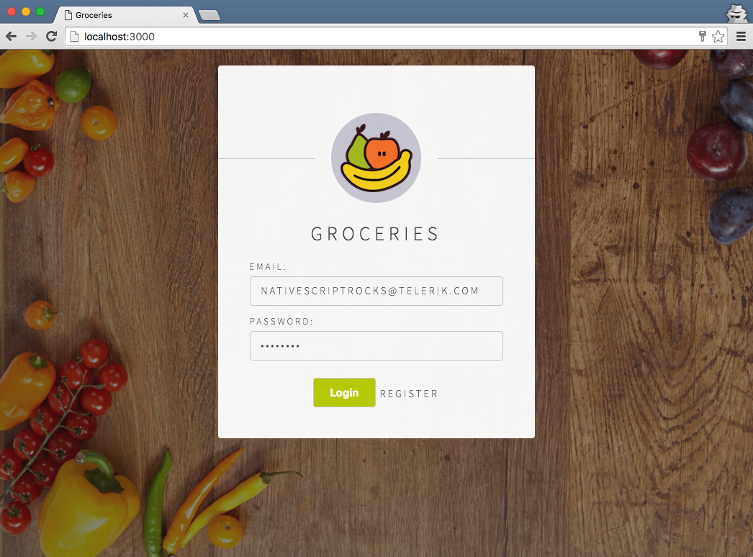
Android
iOS
Web
Notes:
The result is an Android, iOS and Web app that are both written in Angular 2 and share significant elements of their codebase.

Slide 17
Adoption Goals (2016)
Goal for 2016: Grow NativeScript adoption by 15x
3x
5x
2x
Google Angular2 event (“ngConf”);
NativeScript Angular2 push begins
Aug
Sept
Oct
Nov
Dec
Jan
Feb
Mar
Apr
May
Jun
Jul
Aug
Sept
Oct
Nov
Dec
2016
Measured* active developers
(via NativeScript CLI)
Notes:
We’re spreading the good news about {N} + NG!

Slide 18
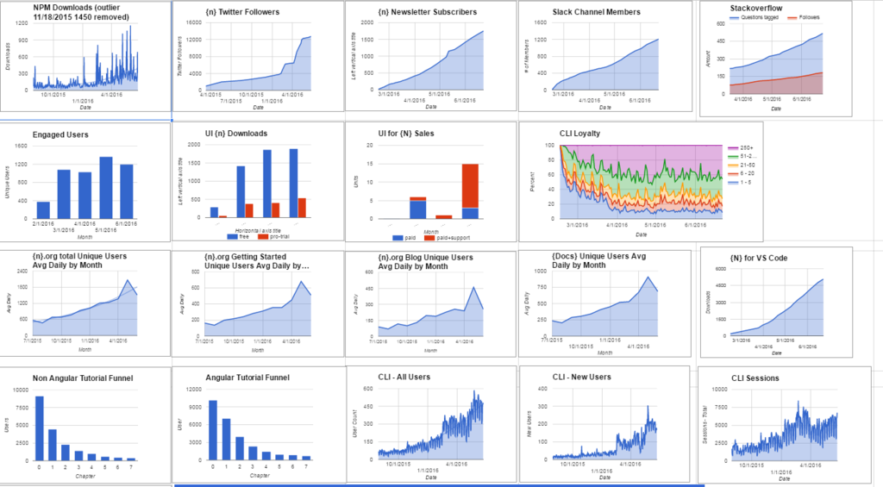
Active monthly CLI users doubled Aug to Dec ‘15
Doubled again Dec to Feb ’16
Steady increase of CLI use and new users
Notes:
We’re seeing a lot of success in this area!

Slide 19
Angular Roadmap
ngConf
Angular 2 RC
{N} ng beta
AngularConnect
(London)
Angular 2 (final)
{N} ng (final)
Microsoft BUILD
Jan
Feb
Mar
Apr
May
Jun
Jul
Aug
Sept
Oct
Nov
Dec
Notes:
The big question. When will Angular 2 be released as a final candidate? Moving fast…RC4 came out yesterday!

Slide 20
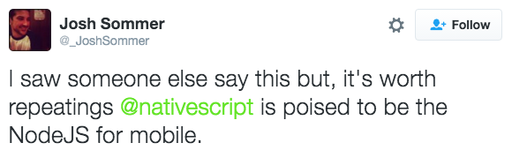
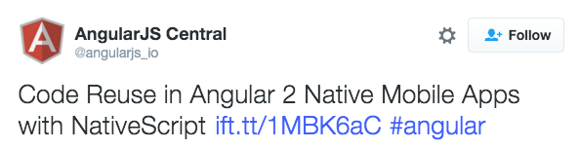
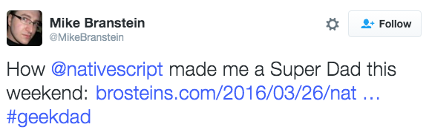
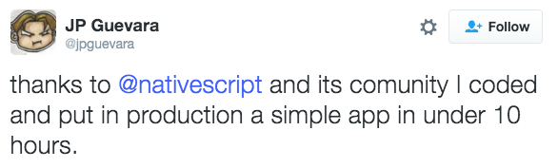
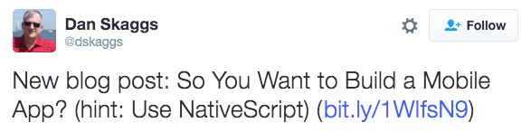
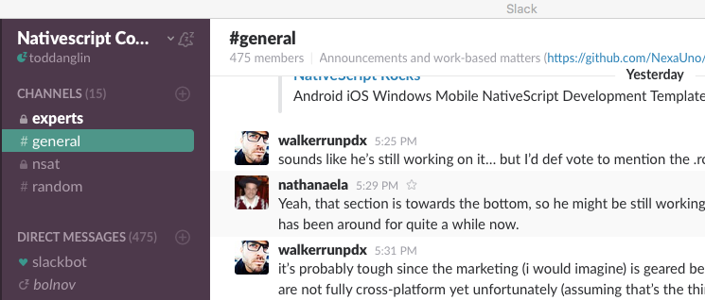
We have an amazing community!

Slide 21
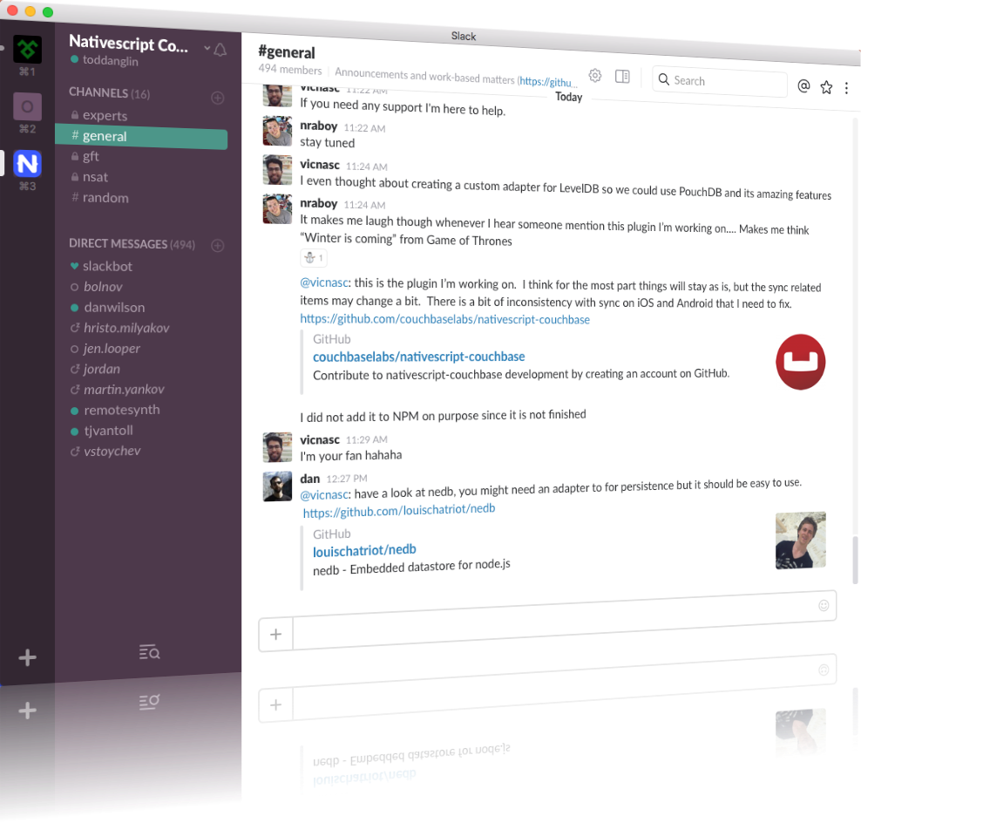
Join the growing NativeScript community on Slack
bit.ly/nativescript-slack

Slide 22
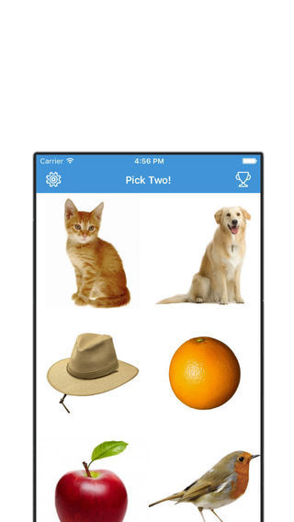
Modulus
Sachse Construction
Day Care
This or That!
PocketSmith
Notes:
Visit our showcase on NativeScript.org to check out a growing list of amazing NativeScript apps

Slide 23


